Slide 1
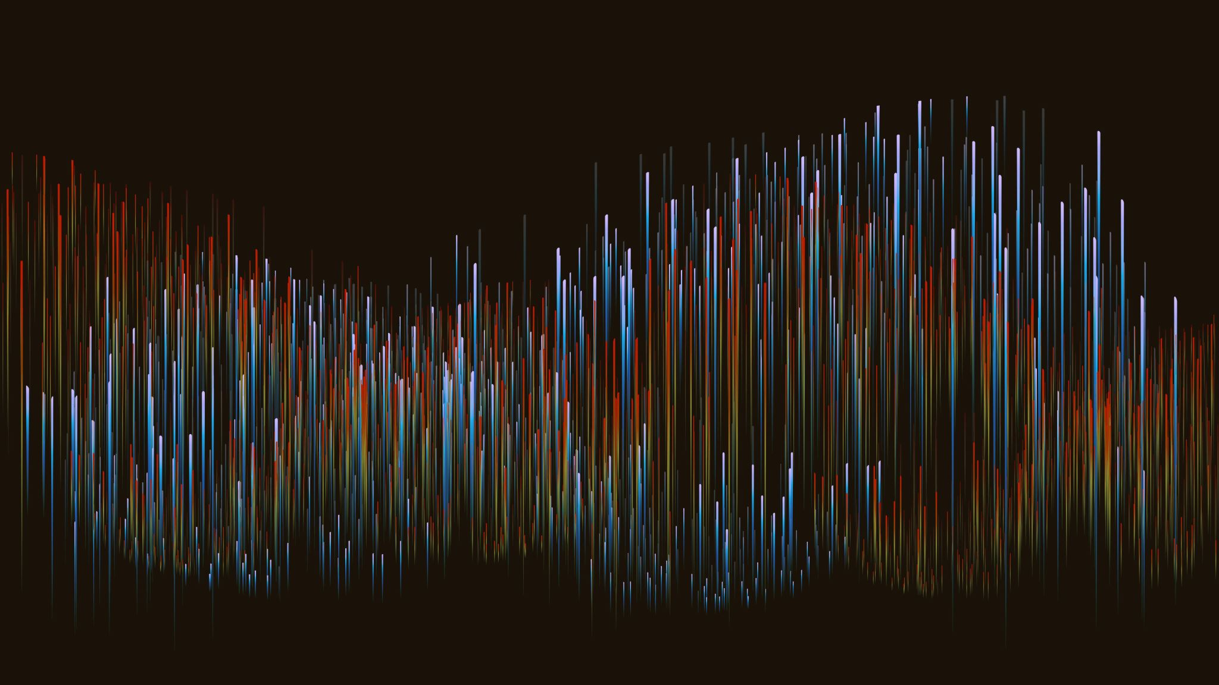
Data Science
Crafting the Perfect Whisky

Slide 2
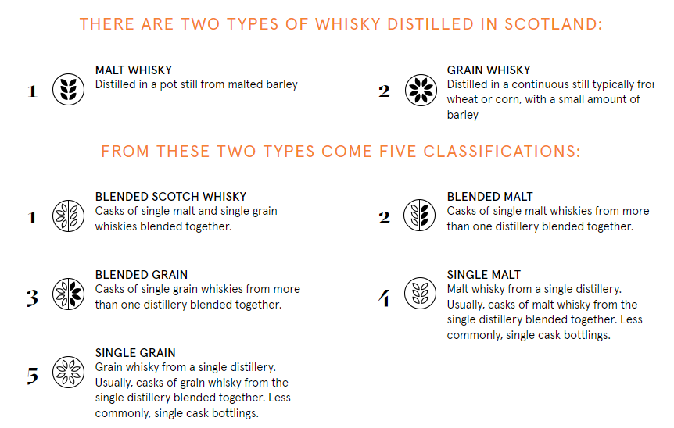
Scotch Whisky Background
Other Data Points
Oak
Toasting Level
Cask Design
Aging
Location
Alcohol Level
Figure 1
Notes:
Whisky maker
Oak from US, France, and Spain

Slide 3
Peat
Peat
“The accumulation of partially decayed vegetation and other organic matter. Sphagnum moss is one of the most common components of peat, hence the origin of the term peat moss. Peat forms when dead plant material, usually in wet areas, is prevented from decaying fully by acidic and anaerobic conditions.”
Peat Reek
Smoke (Amount, Temperature, peat variety, malt exposure time)
Phenol (in ppm)
Lightly peated malt measures two to ten ppm
Medium peated malt will range around 15 ppm
Heavily peated malt will range between 25 and 55 ppm
Super heavy peated malts range from 55 ppm and up

Slide 4
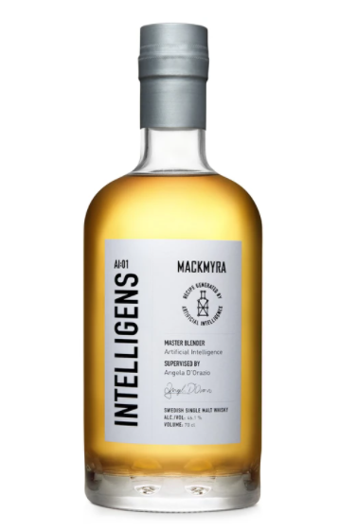
MackmyrA
Intelligens AI:01
The world’s first whisky created by Artificial Intelligence
Powered by Azure cloud platform and AI cognitive services developed by Fourkind
Produced 70 million recipes, master blender tested first batches, provided feedback to AI, and repeat.
Awards – American Distilling Institute’s Gold Label, Best International Malt Whisky, ADC Silver Cube in Product Design
Average whisky rating 86.59 from whiskybase.com
Figure 2

Slide 5
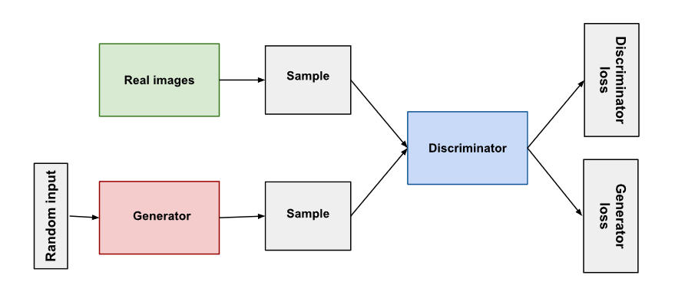
FourKind
“We first explored all current generative models but due to poor performance, ended up creating a proprietary generator-discriminator model that was designed to explore new spaces and generate unique recipes”
Training
Previous recipes
Tasting notes
Consumer ratings
Expert review
Internal ratings
Cask information
Cask Type
Filling stages
Volumes & Alcohol levels
Figure 3

Slide 6
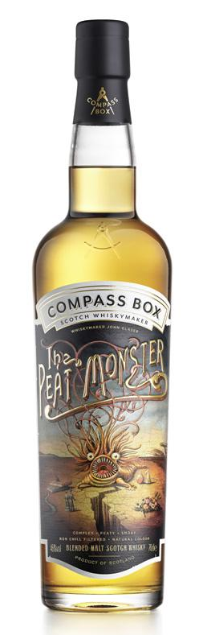
Future
Compass Box Response
“Various analyses can be useful to understand the final composition of a whisky, especially for whiskies like The Peat Monster where phenols analysis can show the changing levels of peatiness as the vatting recipe evolves. However, we have never included a component, or designed a blend, based on prior congeneric read-outs.
This could change, of course. We may be inspired to drill down into a particular molecule or arrangement of molecules, charting how the whisky character changes as we aim to increase the concentration of specific esters or aldehydes. However, our whiskies are enjoyed by people, not machines.
We would only use technical analysis as a whisky making tool if it gave us a new means of accessing delicious whisky, or a conceptual framework in which to explore our craft. ”
- Alex (Compass Box)
22.2 ppm
Figure 4

Slide 7
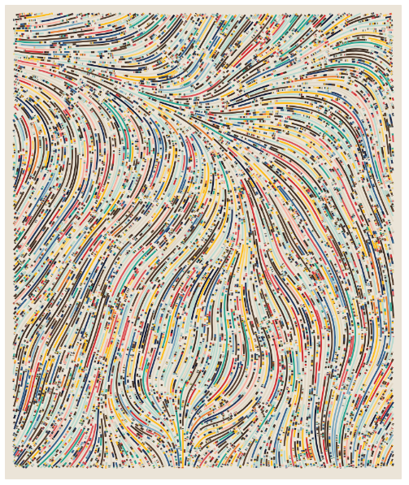
Conclusion – The Human Element
Sports
Baseball
More Homeruns
More strikeouts
Viewing numbers
Basketball
More 3-pointers
Viewing numbers
Art
NFTs
Algorithm designed art.
Human eye filter
Recipes
Whiskey
Perfumes
Desserts
Medicines
Clothing
Figure 5
“our [_____]s are enjoyed by people, not machines”

Slide 8
Sources
Articles
https://www.forbes.com/sites/bernardmarr/2021/04/16/artificial-intelligence-and-whisky-making-the-perfect-blend/?sh=1e63cac1942b
https://mackmyra.co.uk/products/intelligens-ai-01
https://www.fourkind.com/work/mackmyra
https://thewhiskeywash.com/whiskey-styles/scotch-whiskey/scotch-peat-marriage-made-scotland/
Figures
Figure 1 - https://www.compassboxwhisky.com/whiskymakers/
Figure 2 - https://mackmyra.co.uk/products/intelligens-ai-01
Figure 3 - https://developers.google.com/machine-learning/gan/gan_structure
Figure 4 - https://www.compassboxwhisky.com/whiskies/the-peat-monster
Figure 5 - https://perfect-revolve-e25.notion.site/Algorithmic-Art-44c51193844548899969c7e7d904db98

